Slide 1

PS 2: Continuous Indian Sign Language Recognition and Multimodal Dialogue System
Members : R Manoj
Nithin L
Nishanth J
Rachitha K

Slide 2
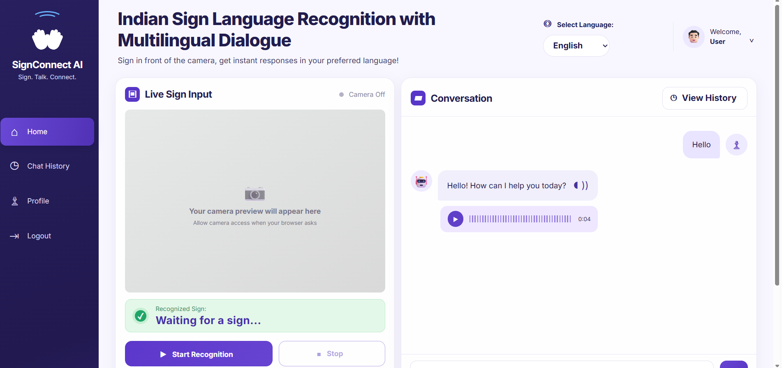
frontend

Slide 3
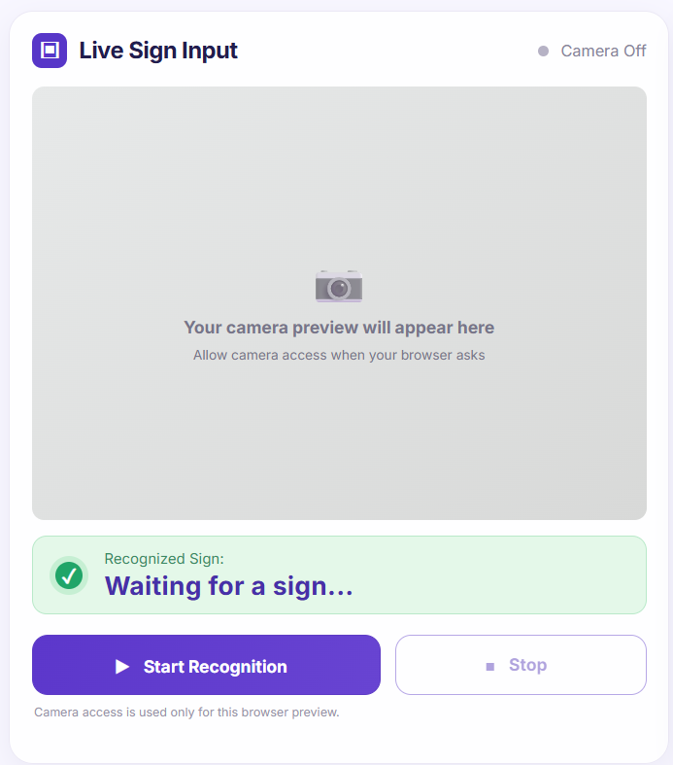
Sign language input live capture

Slide 4
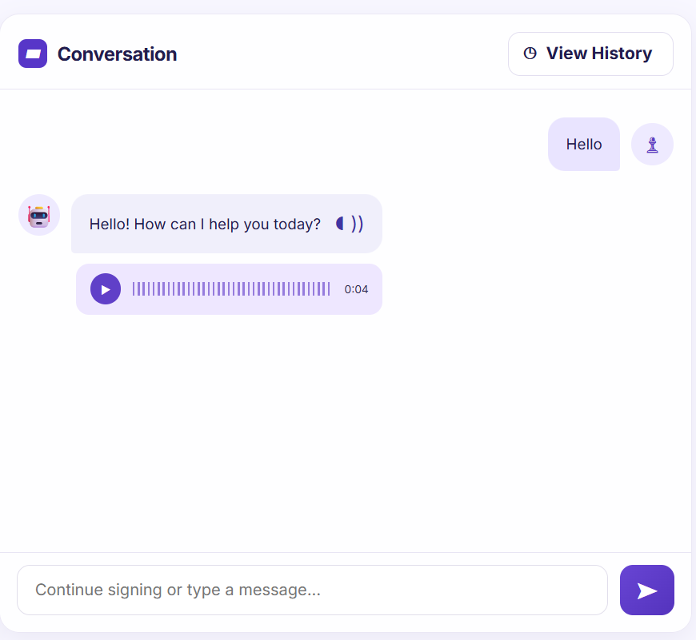
Conversion and history of conversion

Slide 5
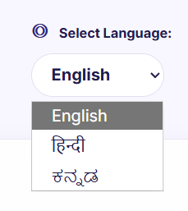
Three types of language can be selected

Slide 6
THANK YOU

